Slide 1
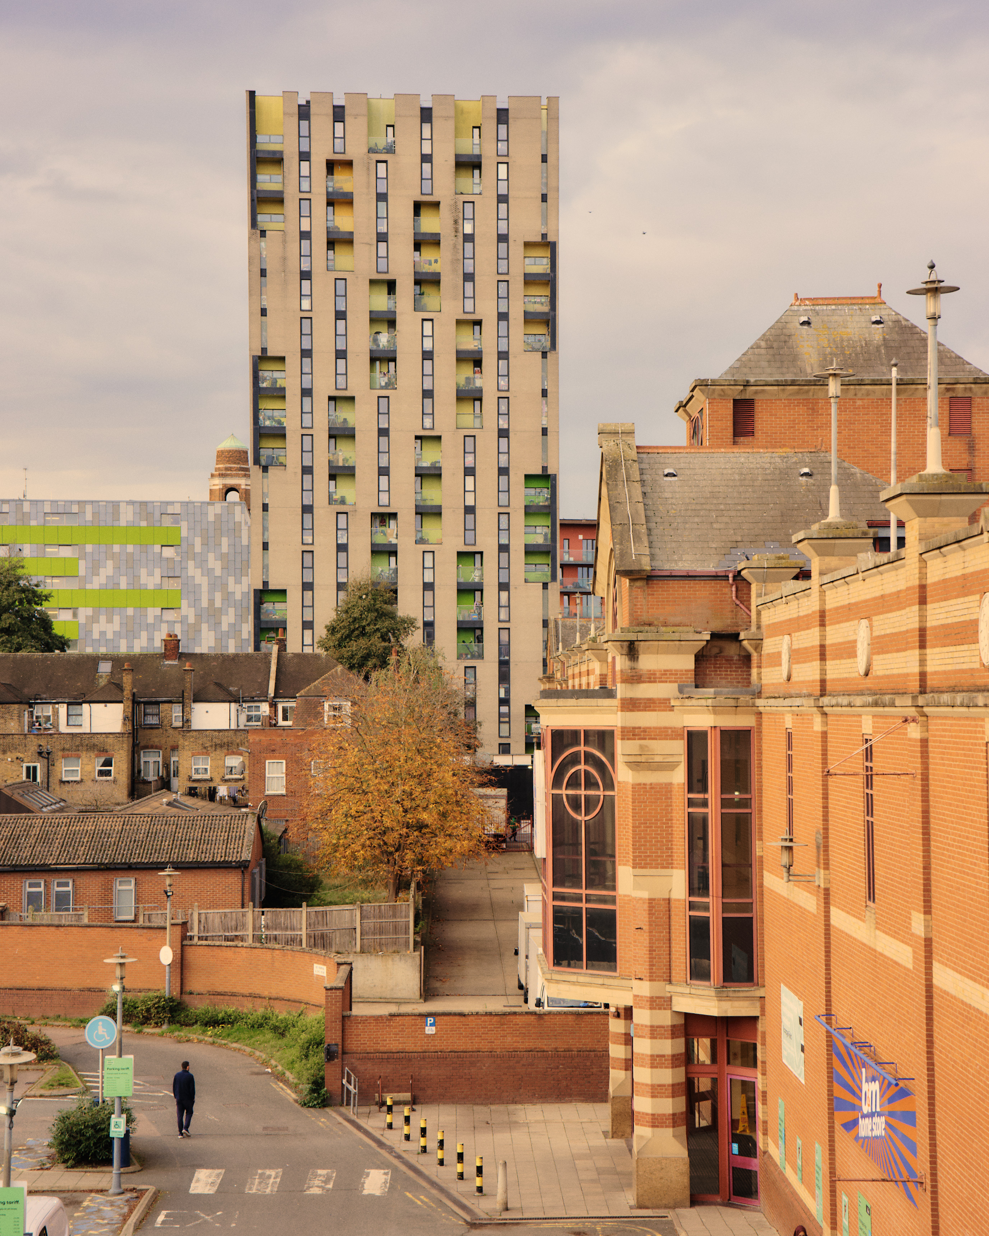

Thames Freeport Public Board 11 December 2025 Building a Better Future Together

Slide 2

What is Thames Freeport?
Thames Freeport is a unique, once-in-a-generation opportunity to stimulate trade, drive innovation, support energy transition, and transform the lives of people in locally - across the London Borough of Barking and Dagenham, London Borough and Havering and Thurrock Council, in Essex.
We believe that Thames Freeport can be a force for positive change in the region and in the world.
Notes:
Our Mission
We are committed to creating a cleaner, more sustainable future for the Thames Estuary. We will do this by attracting investment in clean energy technologies, added-value manufacturing, supporting artificial intelligence deployment and advanced logistics. We will also work with businesses to help them decarbonise their operations.
We believe that Thames Freeport be a force for innovation and economic growth.
We are committed to creating a world-classindustrial cluster that will create jobs andopportunities for people in the region.

Slide 3
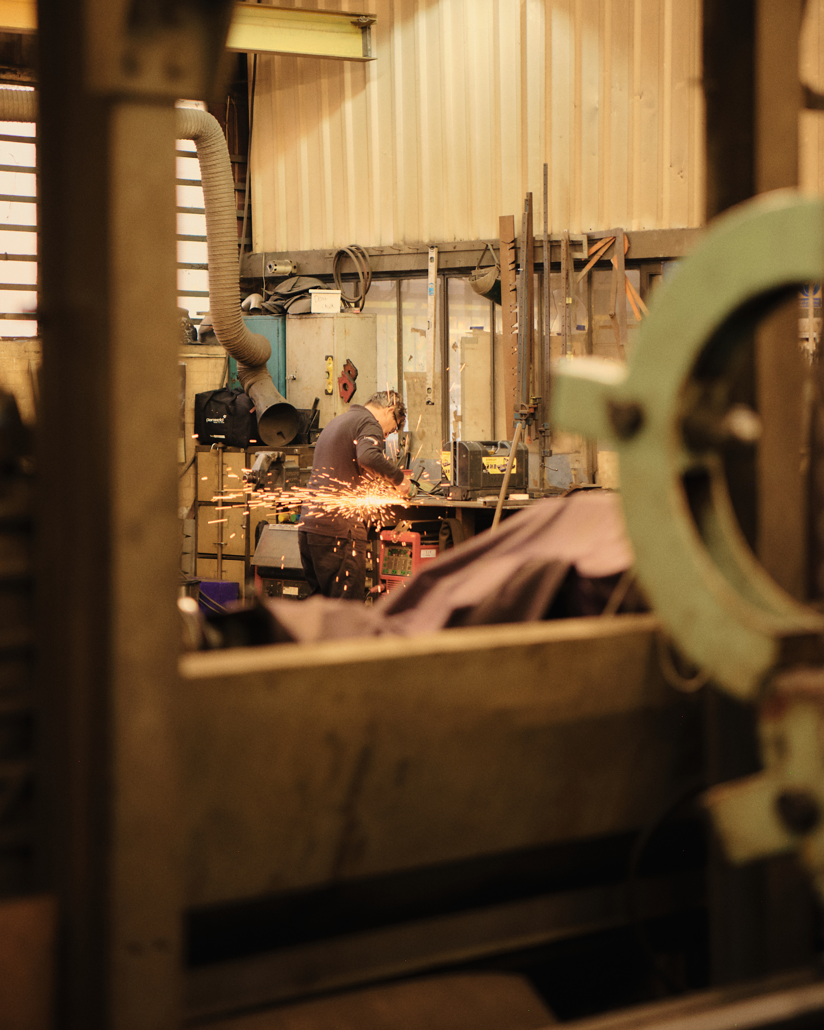
Our Purpose
To connect local people and communities to new sustainable growth.
Building the biggest opportunity in a generation where everyone can share in the prosperity provided by a high productivity economy.

Slide 4
Our Mission
Thames Freeport is a unique, once-in-a-generation opportunity to stimulate trade, drive innovation, support energy transition, and transform the lives of people in London and the boroughs to its east.
We are committed to creating a cleaner, more sustainable future for the Freeport. We will do this by attracting investment in clean energy technologies, added-value manufacturing, supporting artificial intelligence deployment and advanced logistics. We will also work with businesses to help them decarbonise their operations.
We believe that Thames Freeport can be a beacon for innovation and economic growth.
We are committed to creating a world-class industrial cluster that will create jobs and opportunities for people in the region.
We believe that Thames Freeport can be a force for positive change in the region and in the world.

Slide 5




Our values
Sustainability
Fair Growth
We are committed to creating a cleaner, more sustainable future for the Freeport and the UK.
We are committed to creating good jobs, enhanced community value and opportunities for the people in the region in a fair and inclusive way.
Opportunity
Partnerships
A unique opportunity to stimulate trade, drive innovation, support energy transition, and transform the lives of people in London and the boroughs to its east.
We invite all stakeholders to join us to be a part of making positive changes to build a brighter, shared future through partnership.

Slide 6






What do we do?
We are shaping a place where business and communities can prosper together. We are developing the industries of the future, nurturing talent, and making it easier to build what the region needs to thrive now and for generations to come.
38 km along the Thames to the east of London, access to Europe's largest consumer base of 18 million. 40 universities, a skilled workforce, London's capital flows & soft power.
We are hands on, agile partners.
Backed by Government,
pulling policy levers, plugging investors into customers, talent & skills.
AI, clean energy, innovation, tomorrow's skills, a different way of thinking about business & society: we are designed to adapt to change and uncertainty, creating resilience for communities & business.
A masterplan that complements existing local plans, investing in physical and social infrastructure and projects that will create long term growth for the area.
Working to improve local people's live, creating a talent pool and generating jobs. Being a regeneration engine.

Slide 7
What we've achieved – Timeline
Mar 2021 Thames Freeport announced by Chancellor
Sep 2021 First official Freeport open
Nov 2021 Tax incentives begin
March 2023 Full Government approval Board constituted
Oct 2023 New brand and website launch
Oct 2023 £600 million milestone announce
July 2024 £1.3 million skills fund
Sep 2025 £6.6 million invested in Seed Capital Projects (£25m committed)
Nov 2023
Tax relief extended to 2031
Notes:
Why is it important here?

Slide 8
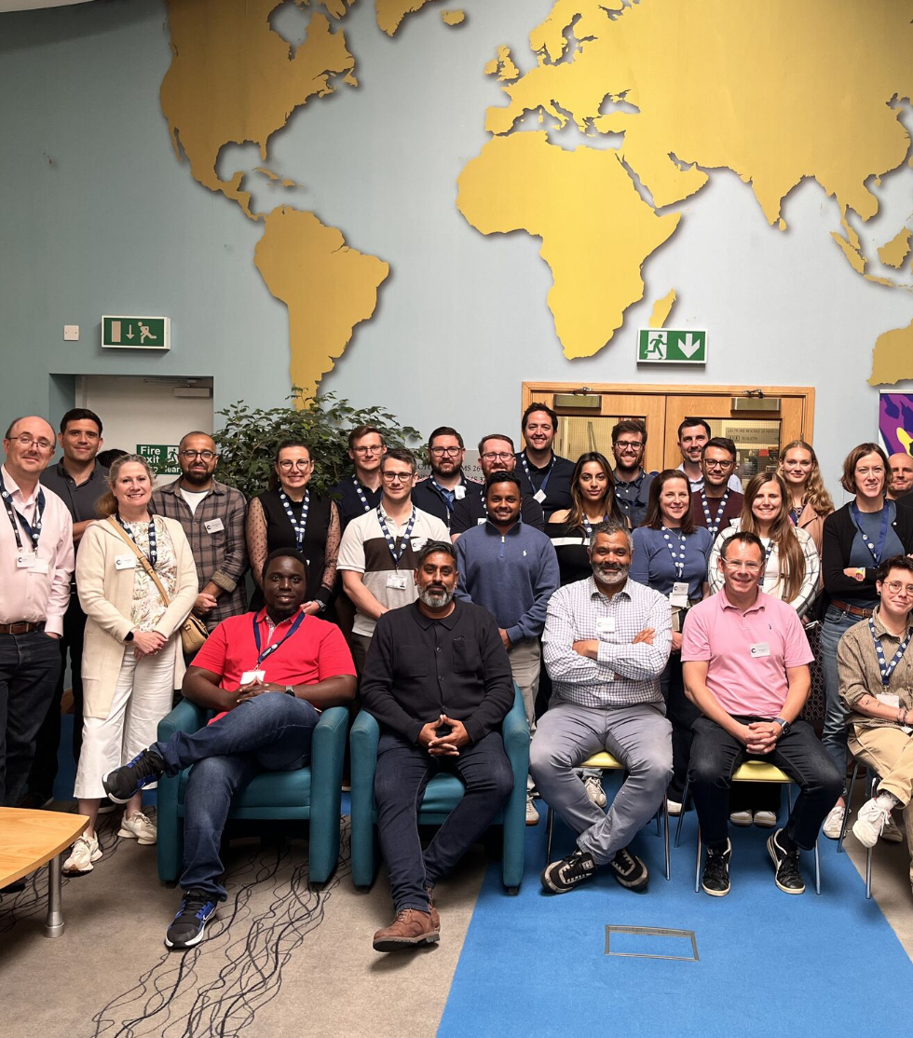
What we've achieved - Inward Investment, Skills and Innovation
1400 jobs created
£2.2 billion invested
1000+ pupils supported
500 adults trained
£2m levy unlocked
136 apprentices started
£25m seed capital investment committed
23,000 new digital visitors

Slide 9
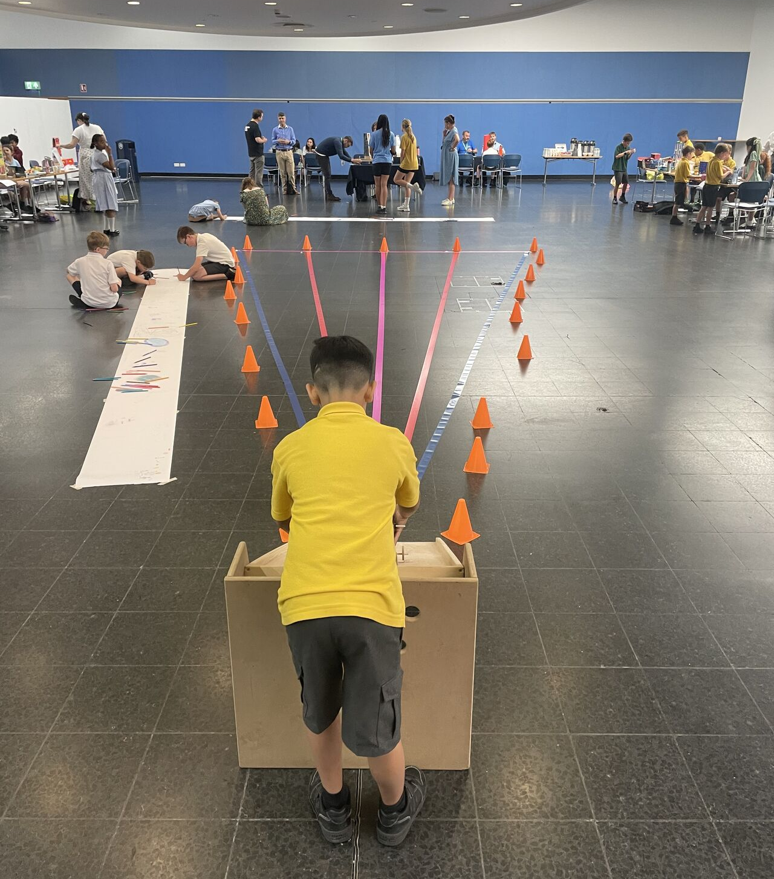
What we've achieved - Skills & Education
Over £1.3m invested so far
£3m investment in 2025/26
26 GCSE students supported into post-16 pathways
Construction, AI, Back to Work, Future Food, Green and Hydrogen skills
UK first Level 3 Hydrogen Safety qualification
1000 adult places offered

Slide 10


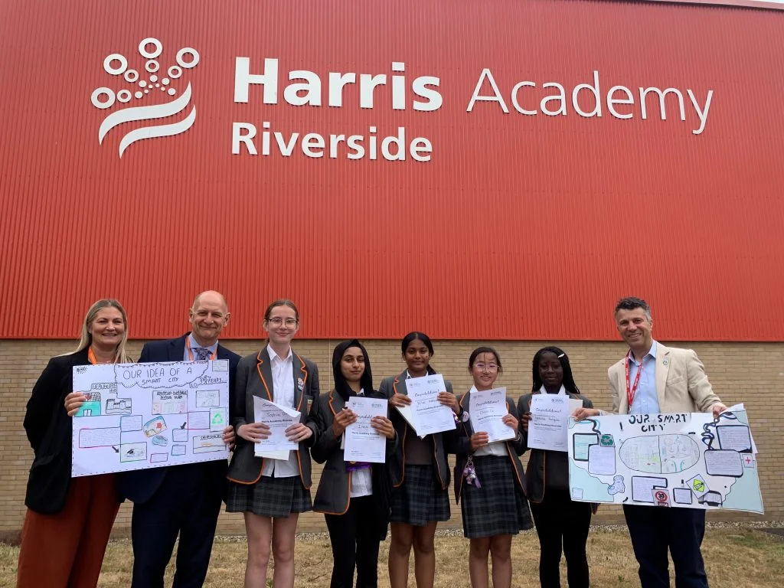

What we've achieved – Investing in the next generation
Thames Freeport have engaged 3 schools in Thurrock to take part in the ‘Smart City Schools Competition’ across ages 9-14.
Our ‘Smart City Schools Competition’ received over 48 submissions, engaging over 220 young people and 8 teachers.
Our newly launched, “Frame the Future: Film Competition” gives young adults ages 18–25 from Barking & Dagenham, Havering, and Thurrock a platform to showcase their stories, ideas, and aspirations for their communities.
This year, Thames Freeport have launched a new competition for all schools in the region. “Design what your area will look like in 2035?”

Slide 11
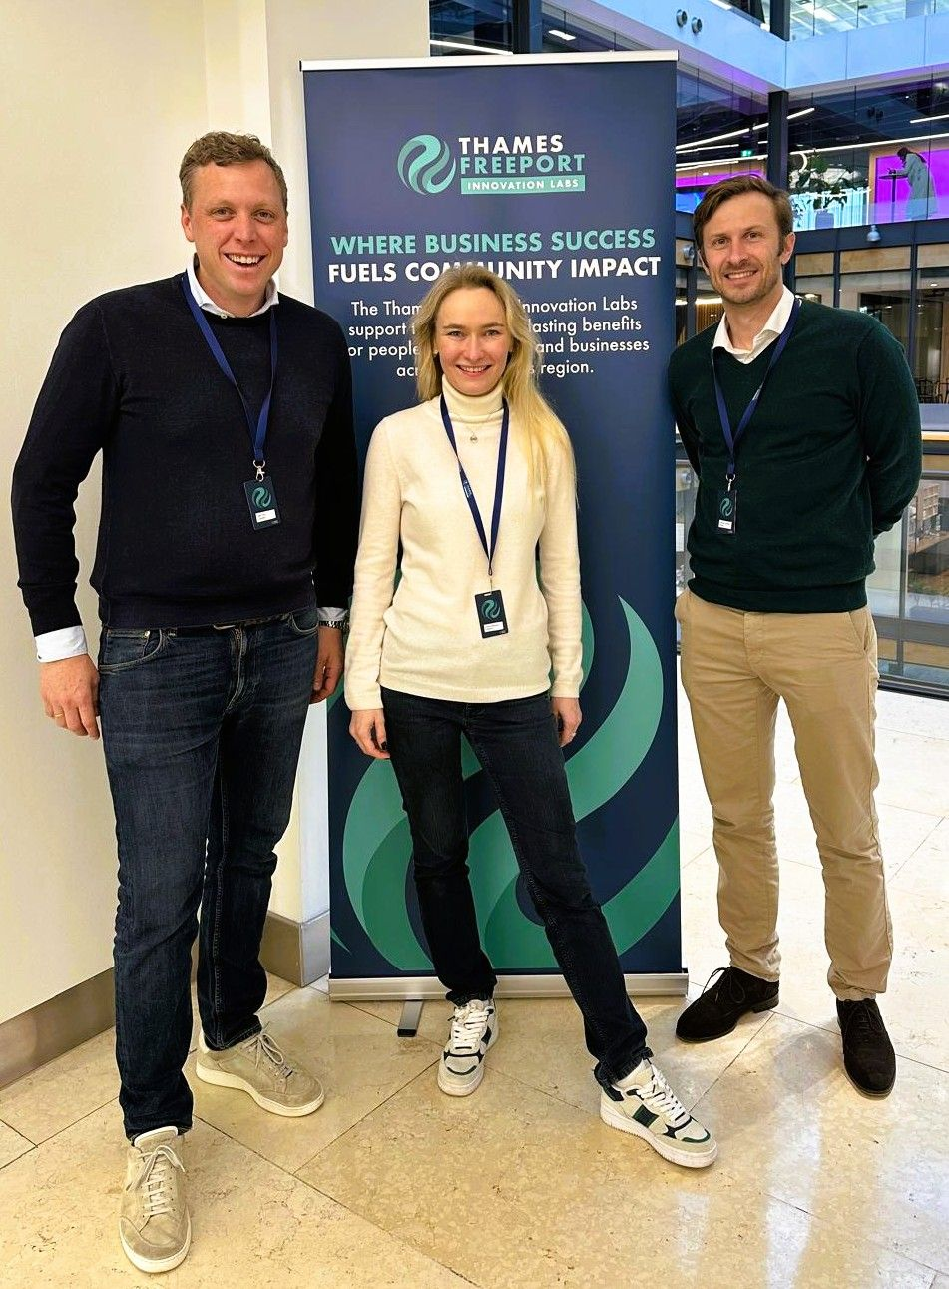
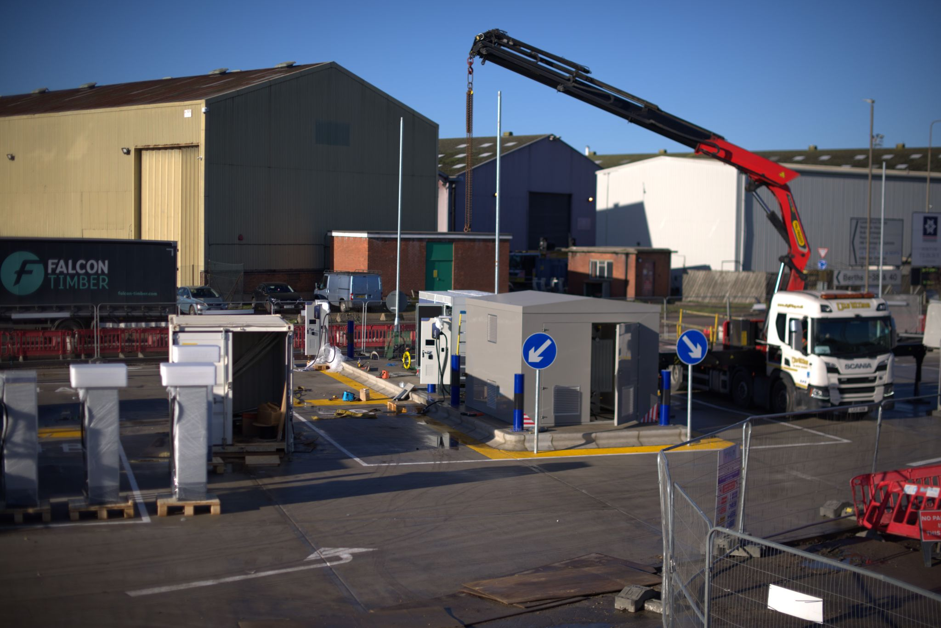
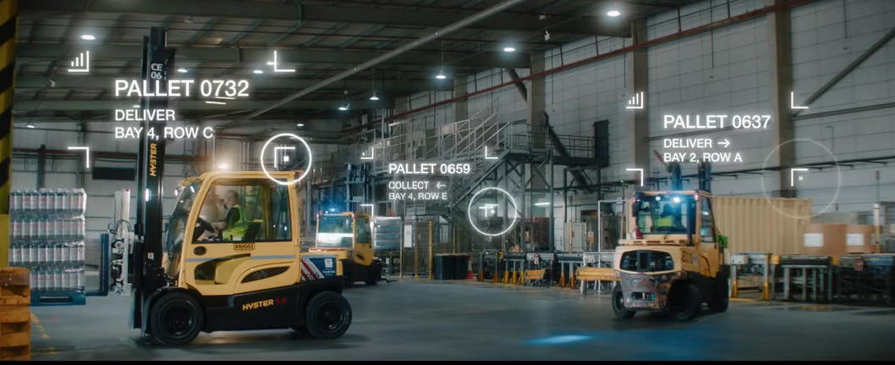
What we've achieved – Infrastructure
eHGV Charging £1m
5G Infrastructure £3m
Connectivity Lab £1.3m
Port of Tilbury eHGV rapid charging hub, is a clean fuel hub on A13 to London.
The charging hub has 16 rapid chargers and has received £1m in funding from the UK Government.
The hub has been strategically designed and located for large fleets.
Faster, reliable 5G for homes, schools and local businesses.
Safer, smoother transport, real-time traffic and freight data.
Local jobs and digital skills as businesses adopt next-gen tech, deployed across all 3 tax sites.
Attract the best innovation from around the world.
148 applications received to increase 25% efficiency to port operations.
Testing in real world environment to be applied to public.

Slide 12
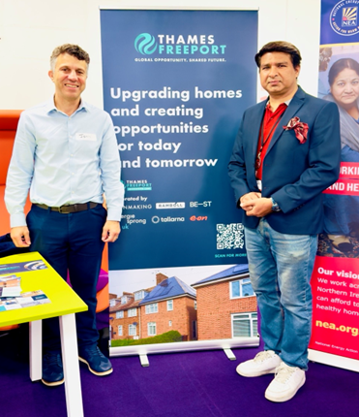
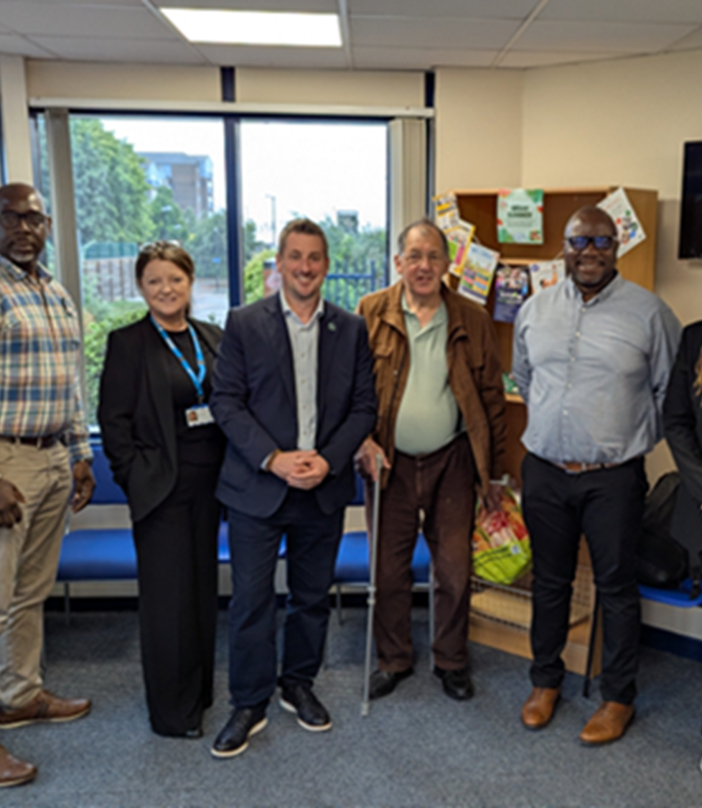
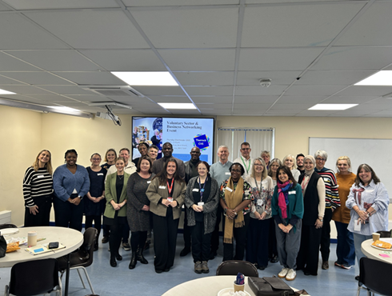
How are we supporting the community? The Thames Freeport Ambassador programme aims to address direct community concerns: make places safer and strengthen trust, create clear pathways into good local jobs with flexible, accessible training, support culture and creativity with inclusive spaces and local events and grow a greener local economy with community energy, volunteering and skills sharing.
400 plus Residents engaged with through local events this year
30 Thames Freeport Community Ambassadors
Ambassadors have engaged with over 300 residents since August
32,000 additional Tilbury Library visits

Slide 13
What’s next?
2026/2027 is going to bring more of a focus on community, skills and innovation
Community Engagement activities:
Increase Thames Freeport Ambassador reach
Support Councils for Voluntary Services (CVS) initiatives
Homes – retrofit
Health Activities
Schools' competitions
Apprenticeships
AI Institute
How can you get involved?
Whether you would like to volunteer, become an ambassador, or share feedback about your area, we would love to hear from you and get you involved head to our website to find out more, or click here to register your interest in Thames Freeport and community activities.
Contact us:
Email: enquiries@thamesfreeport.com
LinkedIn: www.linkedin.com/company/thames-freeport
Facebook: Thames Freeport | London | Facebook
Website: www.thamesfreeport.com

Slide 14
Follow us on LinkedIn and Facebook enquiries@thamesfreeport.com
Thank you

